Slide 1
Assessing risks to bond yield: Vector Auto Regression

Slide 2
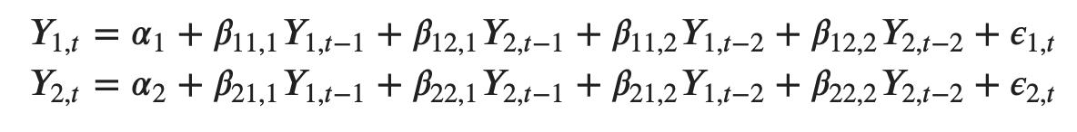
What is a Vector Auto Regression?
A generalization of multivariate auto regressive models (Sims(1980))
Measures the bi causal effects of all the variables within the system of equations
Simply put, it is a multi time series of regressions, but additively accounts for time dependency and bi causal analysis
Used by every single notable central bank in the world: Well researched and very effective
A simple bivariate VAR is specified as below:

Slide 3
The purpose of running a VAR
We can examine relationships between the variables in the system of equations, EX: Currency rates, interest rates and inflation
Accounts for real world complexities such as bi – causal relationships and unpredictability in macro economic variables
Producing dynamic forecasts based on the model, which can give us a general idea of the future
Output of a VAR model
Impulse response functions
Granger causality
Forecasts
Variance decomposition using the Cholesky algorithm

Slide 4
Model specification
The variables used are log of 10 year US treasury bond yields, log of CPI and interest rates
Data is taken from 2000 – 01 – 01 until 2021 – 07 – 01 from the St. Louis Fed at a monthly frequency

Slide 5
Impulse response function
Shows what would happen to Y if X is shocked by 1 standard deviation
Modelled as a function of historical behaviour
In the case of bond yields, inflation and interest, it’s useful to see how yields react to changes in monetary policy

Slide 6
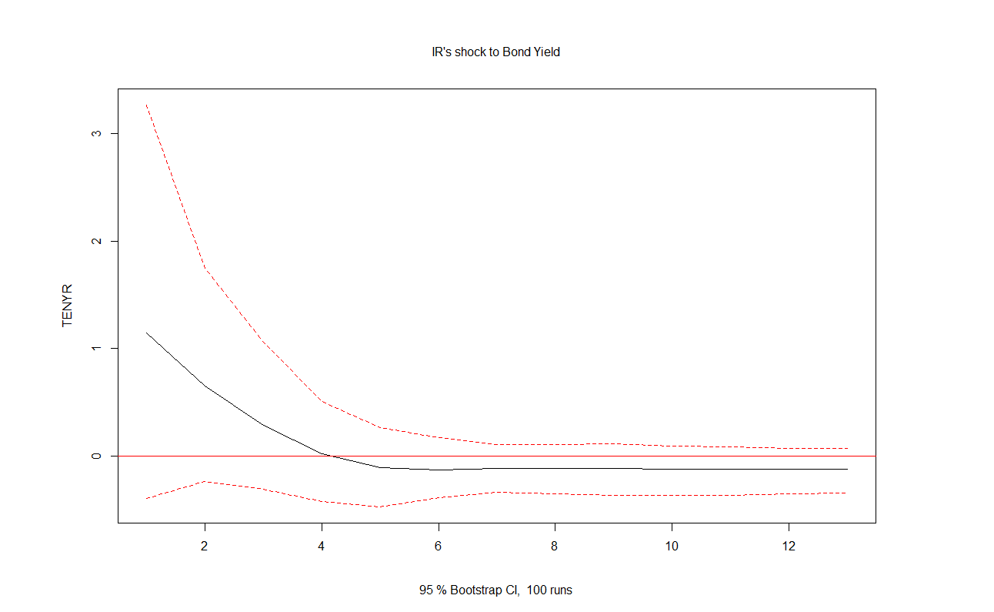
Interest rates on bond yields (% change)
Y axis: % change of bond yields
Shows bond yields when interest rates are shocked by 1 S.D.
Bond yields change slightly in the short term, but zero out in the long run
X axis: Months / Time periods of the simulation

Slide 7
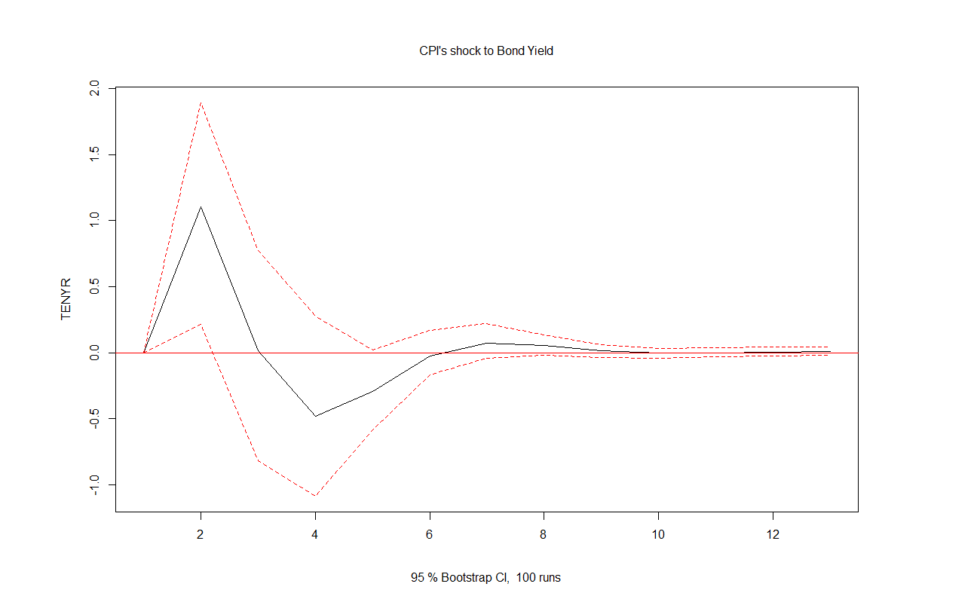
Inflation on bond yields (% Change)
Y axis: % change of bond yields
Shows bond yields when inflation is shocked by 1 S.D.
Shows mean reversion, because inflation is expected to revert back to the mean whenever it is shocked (Monetary policy)
X axis: Months / Time periods of the simulation

Slide 8
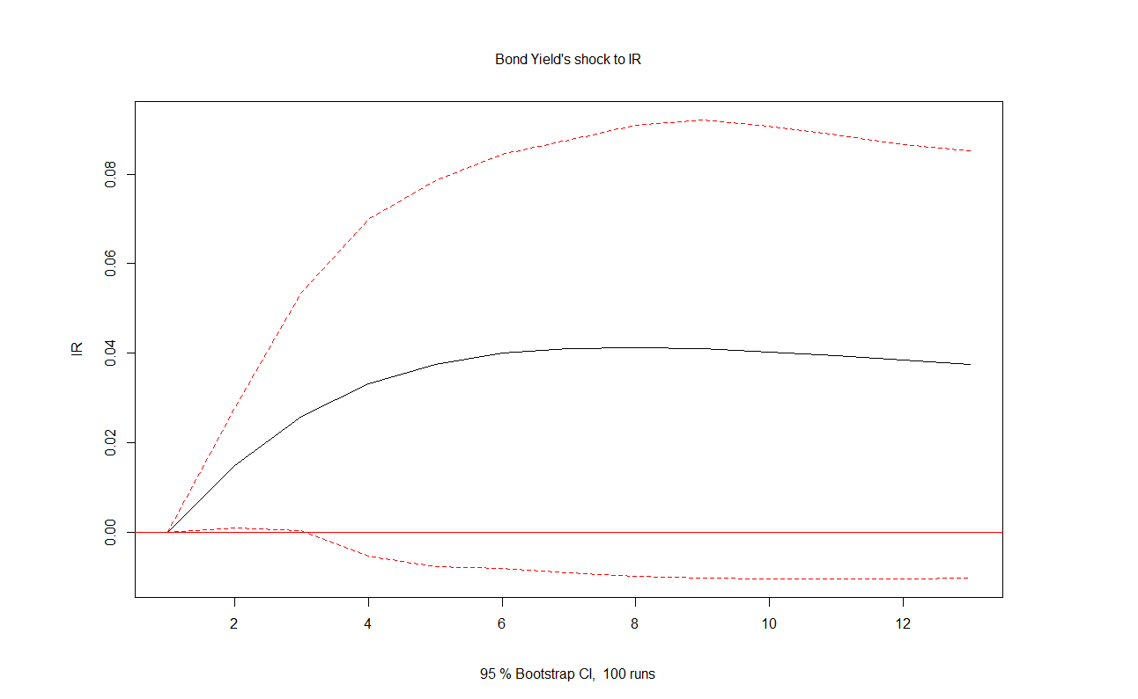
Bond yields on interest rates
Y axis: % change of interest rates
Shows interest rates when bond yields are shocked by 1 S.D.
Interest rates tend to change when Bond Yields are shocked. Monetary policy + Exogenous variation
X axis: Months / Time periods of the simulation

Slide 9
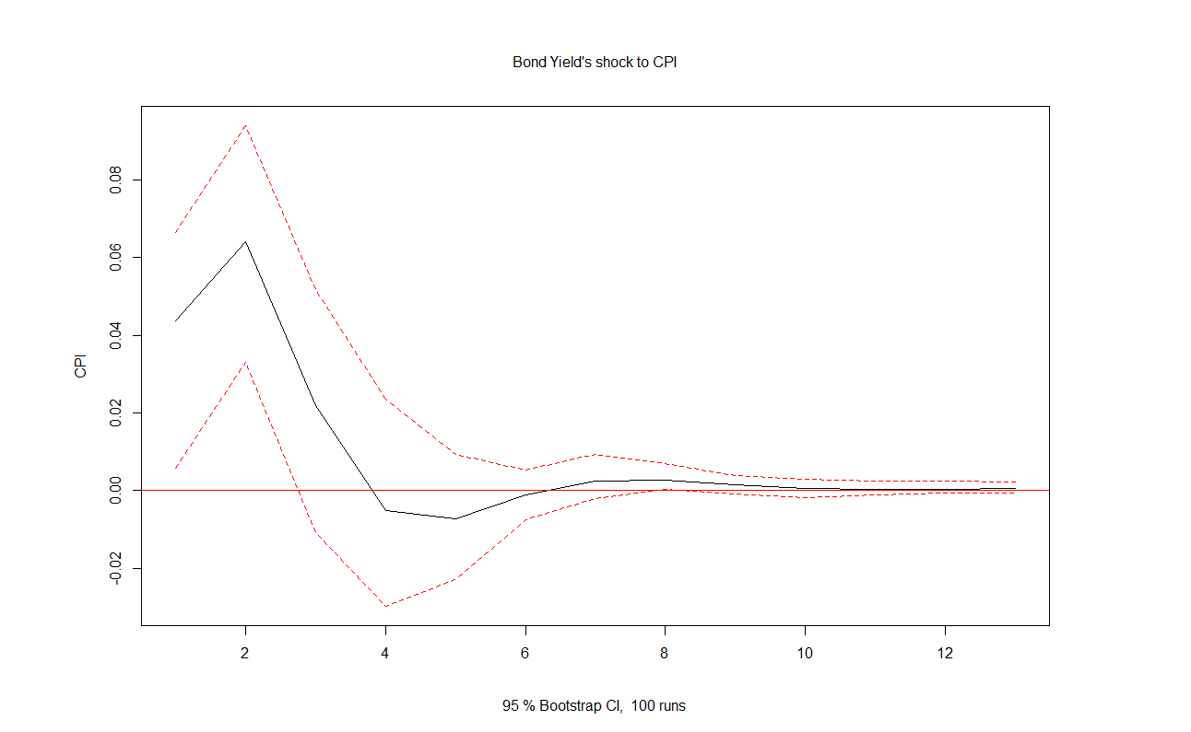
Bond yields on inflation
Y axis: % change of inflation
Shows inflation when bond yields are shocked by 1 S.D.
Inflation is jumpy when Bond Yields are shocked: Most likely caused by exogenous variation
X axis: Months / Time periods of the simulation

Slide 10
Results from the graphs
In general, bond yields will revert back to their average rates in the long term
We only need to care for short term shocks in bond yields when inflation and interest rates change
Bond yields tend to not cause changes in inflation or interest rates

Slide 11
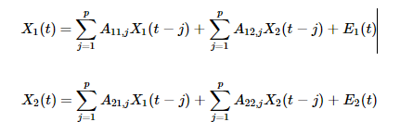
Granger causality
If X ‘Granger causes’ Y, it means that past values of X contains information that helps predict future values of Y.
Useful for forecasting and materializing time dependency in macro economic variables

Slide 12
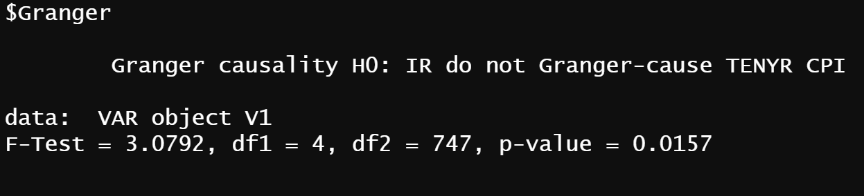
Interest rates
Because P<0.05, we can conclude that Interest rates and its historical values explain some of the future variation in both bond yields and inflation.
Interest rates Granger cause bond yields and inflation

Slide 13
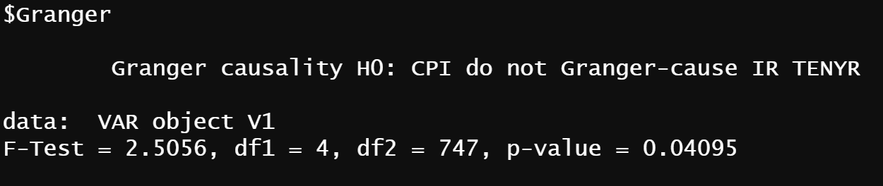
Inflation
Because P<0.05, we can conclude that Inflation rates and its historical values explain some of the future variation in both bond yields and interest rates.
Inflation Granger cause bond yields and interest rates

Slide 14
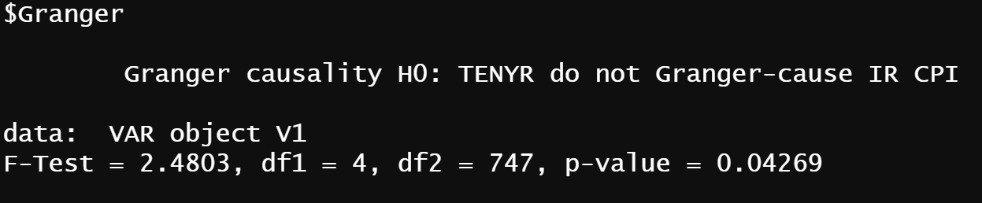
Bond Yields
Because P<0.05, we can conclude that Bond yields rates and its historical values explain some of the future variation in both inflation and interest rates.
Bond yields Granger cause inflation and interest rates

Slide 15
Granger causality results
The variables ‘Granger cause’ each other: Past values of bond yields, inflation and interest rates can explain some of the variation in each other’s future
This means that we can run forecasts and that we know the auto regressive portion of our model properly captures the time dependency in the data

Slide 16
Forecasts
Dynamic forecasts
Called a Fanchart: The darkest middle portion of the forecast period is the most likely values that the variable will take, and he lighter outer regions are the confidence intervals, with the lighter portions showing less likely outcomes for the variable
This forecast is useful because we know how each variable reacts to standard deviation shocks, as well as the relationships between each of them

Slide 17
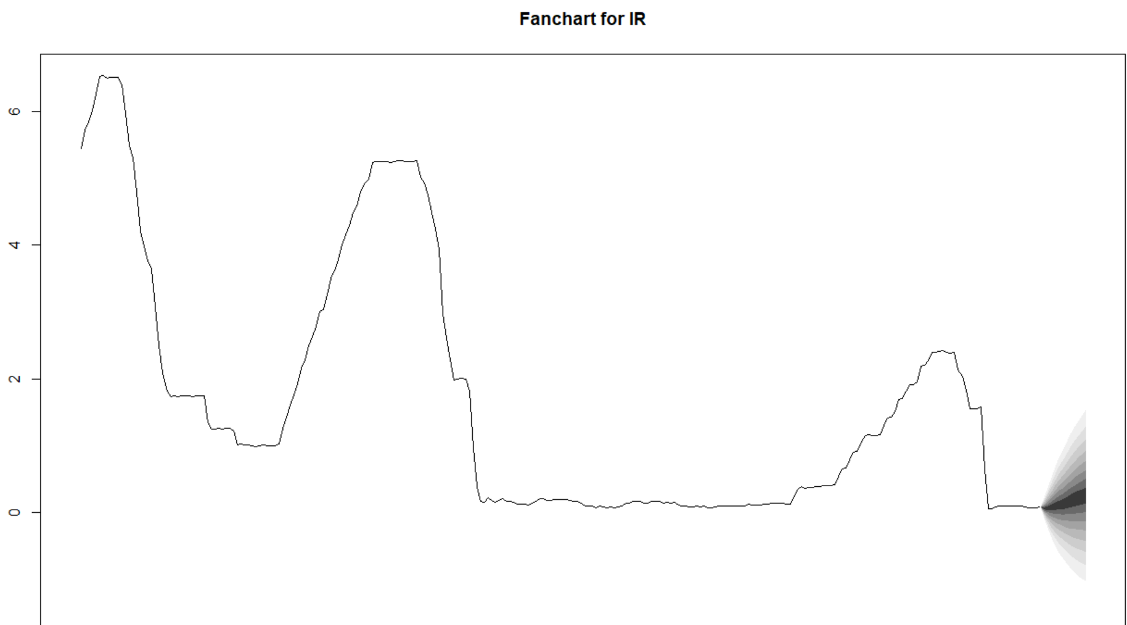
Interest rate Fanchart

Slide 18
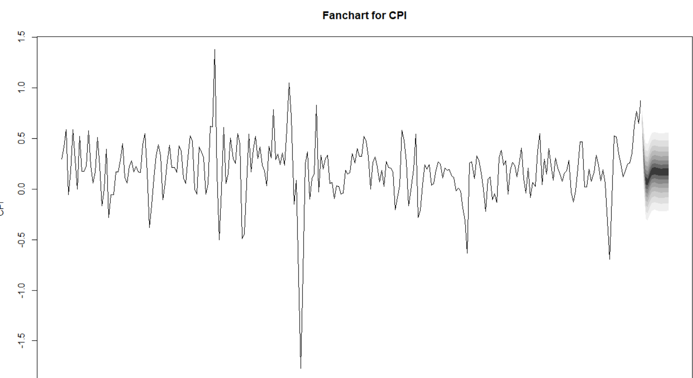
Inflation rate Fanchart

Slide 19
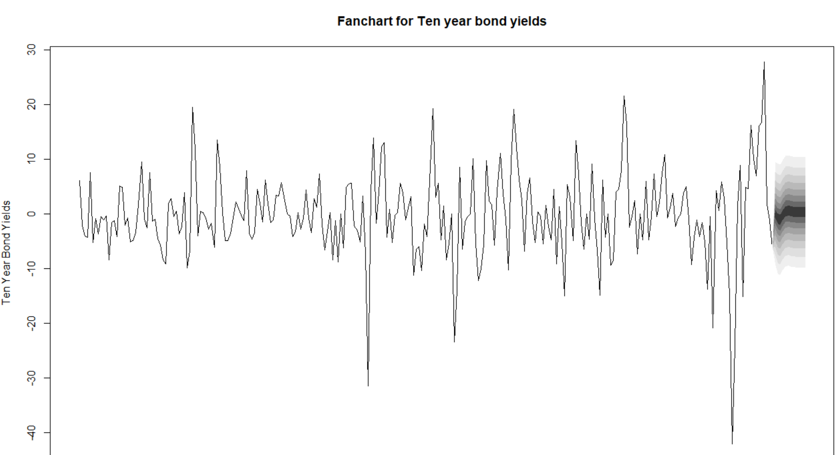
Bond yield Fanchart

Slide 20
Fanchart results
We expect all three variables to exhibit normal behaviors, in – line with the Fed’s monetary policy view
Highest tail risk would belong to bond yields, with a 2 standard deviation shock potentially causing a 15% change (2 SD shocks are unlikely, but possible)
Not much tail risk present in interest and inflation rates

